Slide 1
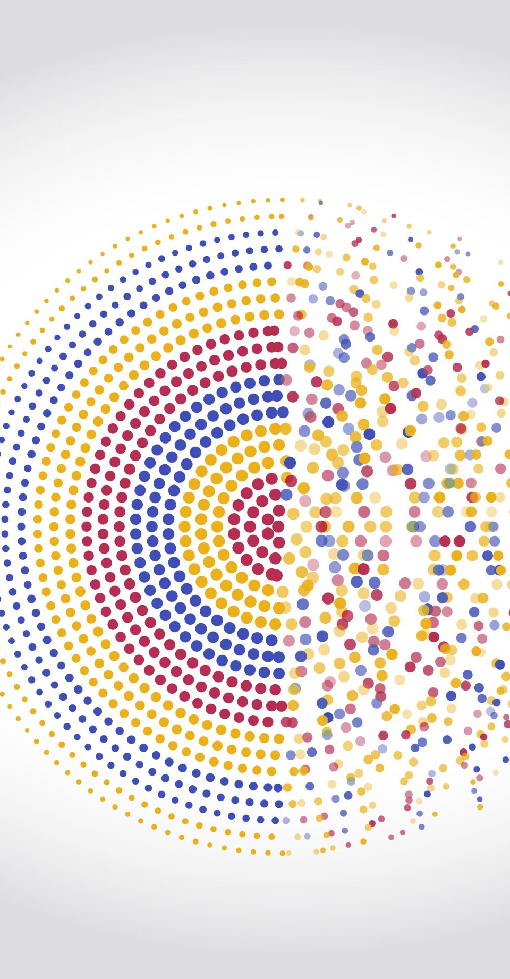
Week 4
Kaggle or bust!!

Slide 2

Quiz
How to decide what to do with missing data?
Show excel
Neural nets and deep learning
Transformers and neural nets
Show excel for transformer
Show code for essay [BERT=98% Accuracy]
https://www.kaggle.com/code/ansarmuhammad72/fine-tuned-bert-llm-text-classificaiton/edit/run/162584008
Logs are here [BERT]:
https://www.kaggle.com/code/ansarmuhammad72/fine-tuned-bert-llm-text-classificaiton/log?scriptVersionId=162821260
NN / TensorFlow simulator
https://playground.tensorflow.org/
Demo / Essay prediction
Private
https://www.kaggle.com/code/ansarmuhammad72/fine-tuned-bert-llm-text-classificaiton/edit/run/162584008
Public
https://www.kaggle.com/code/ankit6937/fine-tuned-bert-llm-text-classificaiton
Homework
Quiz
References

Slide 3

Homework!
https://www.kaggle.com/datasets/sunilthite/llm-detect-ai-generated-text-dataset
About Dataset
In this Dataset contains both AI Generated Essay and Human Written Essay for Training Purpose
This dataset challenge is to develop a machine learning model that can accurately detect whether an essay was written by a student or an LLM
The competition dataset comprises a mix of student-written essays and essays generated by a variety of LLMs.

Slide 4

References
Transformers
Transformer Neural Networks, ChatGPT's foundation, Clearly Explained!!
https://www.youtube.com/watch?v=zxQyTK8quyY
Solution to essay problem
Fine Tuned BERT-LLM Text Classification
https://www.kaggle.com/code/ankit6937/fine-tuned-bert-llm-text-classificaiton
Week 4 files are uploaded to github

